Slide 1
General Searches, Publications and Resources
A Presentation On
Notes:
© Copyright Showeet.com – Creative & Free PowerPoint Templates

Slide 2
Outlines of our Presentation
01
02
General Searches
Publications
Short description here
Short description here
03
Resources
Short description here
Notes:
© Copyright Showeet.com – Creative & Free PowerPoint Templates

Slide 3
General Searches
01
Notes:
© Copyright Showeet.com – Creative & Free PowerPoint Templates

Slide 4
What is General Search ?
General search means a search conducted during any number of successive hours not exceeding six without the object of the search being specified
This is the best search to use if you wish to find a large number of records on a topic which you can define yourself according to subject matter geography and chronology
Notes:
© Copyright Showeet.com – Free PowerPoint Templates

Slide 5
General Search techniques
Start with the basics.
Search using voice
Choose words carefully
Don't worry about the little things
Find quick answers
Notes:
© Copyright Showeet.com – Creative & Free PowerPoint Templates

Slide 6
Advantages of General Search
Variety: One can get variety of information by general search.
Precision: By general search refined or more precise results can be found.
Time Saving: By general search one can save one's valuable time and find result quickly.
Notes:
© Copyright Showeet.com – Creative & Free PowerPoint Templates

Slide 7


Search Engines for General Searches
Google
Bing
9

Slide 8

1 image says more
…than a thousand words
Notes:
© Copyright Showeet.com – Creative & Free PowerPoint Templates

Slide 9

PUBLICATIONS SEARCH
Notes:
© Copyright Showeet.com – Creative & Free PowerPoint Templates

Slide 10
What is Publication Search ?
A publication search is one that gives you access to all available volumes and issues of a selected publication.
Notes:
© Copyright Showeet.com – Creative & Free PowerPoint Templates

Slide 11
Types of Publications
Most Common types of Publications includes
Newspapers
Books
Popular Magazines. Trade Journals. Scholarly Journals.
Notes:
© Copyright Showeet.com – Creative & Free PowerPoint Templates

Slide 12
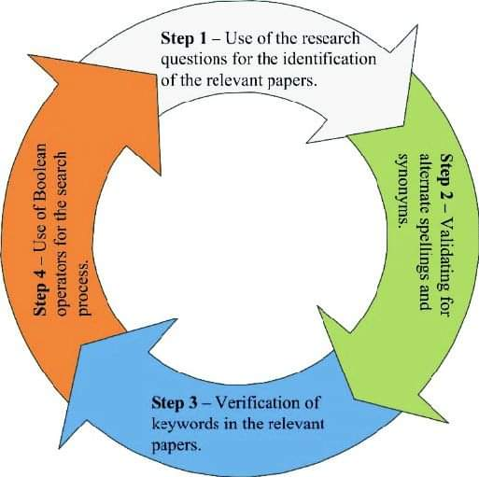
Process of Publication Search

Slide 13
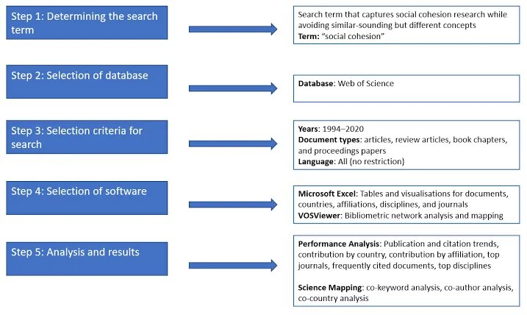

Slide 14
Resources
Searching
Notes:
© Copyright Showeet.com – Creative & Free PowerPoint Templates

Slide 15

What is Resource Search ?
In general, Web pages and documents on the Internet that provide useful information. While an online resource is typically data and educational in nature, any support software available online can also be considered a resource.
Notes:
© Copyright Showeet.com – Creative & Free PowerPoint Templates

Slide 16
Ways to Search for Resources ?
Find an article.
Peer reviewed articles.
Find an article from a citation.
Using Google Scholar.
Find a book or video in the library.
Find a specific journal or magazine.
Notes:
© Copyright Showeet.com – Creative & Free PowerPoint Templates

Slide 17
Where to find Resources?
Information can come from virtually anywhere — social media, blogs, personal experiences, books, journal and magazine articles, expert opinions, newspapers, and websites — and the type of information you need will change depending on the question you are trying to answer.
Notes:
© Copyright Showeet.com – Creative & Free PowerPoint Templates

Slide 18

Useful tools to seek Resources as a Student
Better Explained
Khan Academy
Google Docs
YouTube
Quizlet
Audacity
Gimp
Notes:
© Copyright Showeet.com – Creative & Free PowerPoint Templates

Slide 19
Glimpse of the Presentation
Notes:
© Copyright Showeet.com – Creative & Free PowerPoint Templates

Slide 20

Contexts of this Presentation in Short
The whole topic of this presentation deals with the different searches that will be essential for running a research project.
Different types of searching methods can save enormous amount of our time while doing even a basic project.
Notes:
© Copyright Showeet.com – Creative & Free PowerPoint Templates

Slide 21
Also!
General Search can save a great amount of time as it allows users to find anything fast.
Publication Search can greatly enhance the quality of our research paper if we know how to use this techniques properly.
And Finally the Resource Searching is one of the fundamental part of a research as it holds all of the information, journals, facts of the whole world and without them a research paper will always be incomplete.
Notes:
© Copyright Showeet.com – Creative & Free PowerPoint Templates

Slide 22
Thank You !
For Your Precious Moments
Notes:
© Copyright Showeet.com – Creative & Free PowerPoint Templates

